Slide 1




CAPSTONE
PROJECT
Presented by Kishore V
FEB 25' Batch
DA & DS

Slide 2



Overview
Introduction
Data Storage
Objective
Unsupervised (Clustering)
Web Scrapping
Supervised (Accuracy)
Data cleaning & EDA
Model Selection
Conclusion

Slide 3




Introduction
This project aims to analyze e-commerce product data (specifically shoes) scraped from online platforms. The primary goal is to build a machine learning model that can classify products based on features like brand, price, and user rating, and uncover hidden patterns using clustering

Slide 4



Objective
Analyze e-commerce shoe product data scraped from online platform (AMAZON).
Visualize insights using charts and plots and do EDA.
Use clustering (K-Means) to create a clusters under UNSUPERVISED LEARNING.
Compare models (SUPERVISED LEARNING) like
Logistic Regression
SVM
K-Nearest Neighbor
Random Forest
XGBoost
Handle imbalanced data using SMOTE.
Evaluate models using accuracy and F1-score.
Choose best model based on performance and accuracy.

Slide 5




Web Scrapping
Data was scraped from an AMAZON using Selenium and BeautifulSoup.
Focused on the Shoes category across multiple pages.
Extracted features:
Brand
Product Title
User Rating
Price

Slide 6
Data Cleaning & EDA
Removed null values and duplicates.
Converted rating column to float formats.
Ensured data types matched the modeling requirements.
Created the new column based on the title like Sneakers, running shoe, walking, others under EDA.

Slide 7

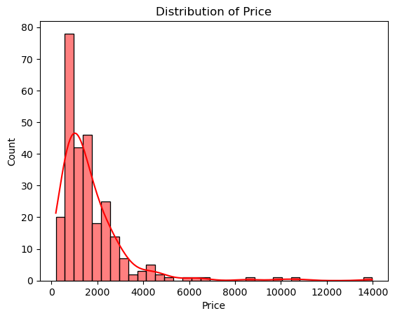
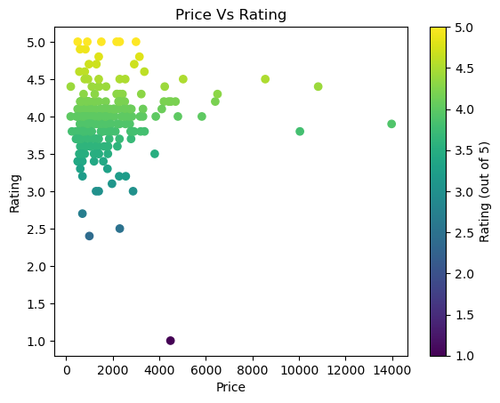



Slide 8
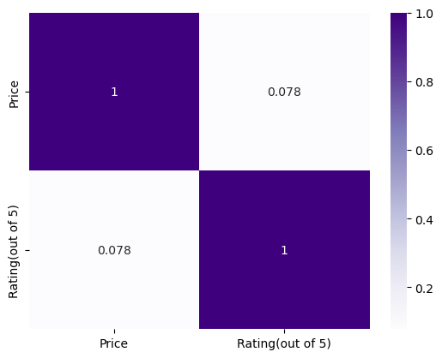
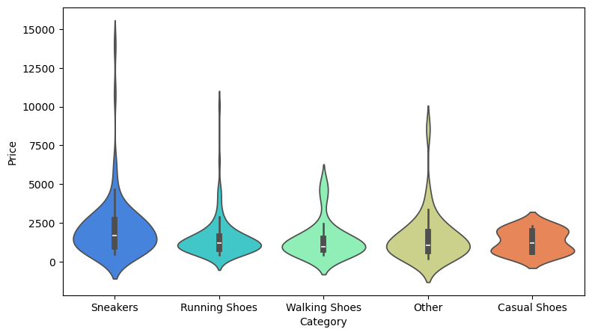

Slide 9
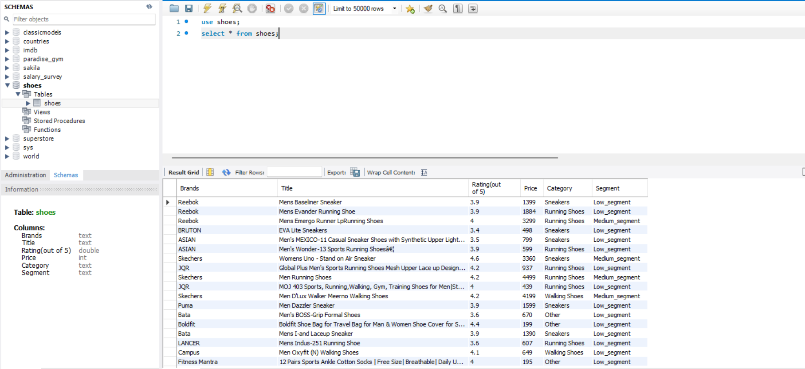
Data Storage
Used Table Data Import Wizard to import the data into MySQL

Slide 10


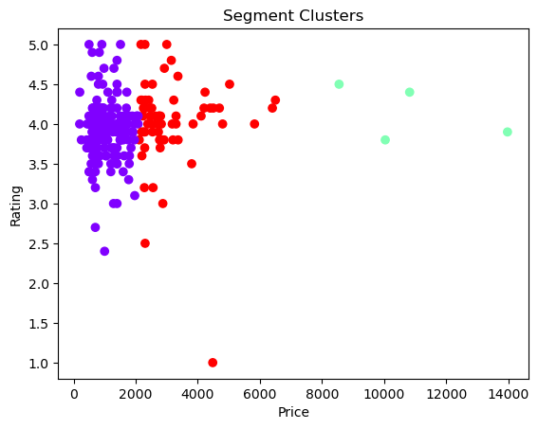
Unsupervised Learning
Applied KMeans Clustering with 3 clusters based on domain knowledge.
KMeans(n_clusters=3,n_init=10,random_state=42)
Used Price and Rating to group products into customer segments.
Each product was assigned a segment label:
Low_segment
Medium_segment
Premium_segment
This segmentation helps understand pricing vs quality perception.
Clustered output visualized using scatter plot with colored segments.

Slide 11
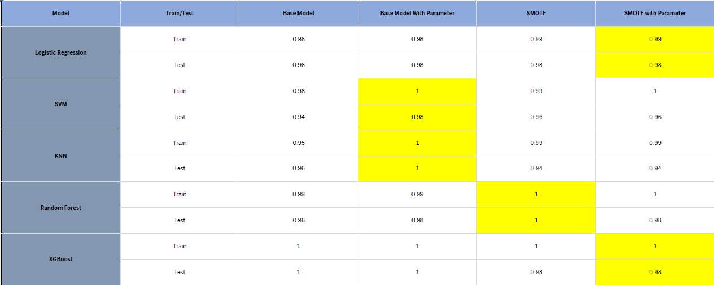
Supervised Accuracy

Slide 12


Model Selection
RF - SMOTE
XG - SMOTE TUNED
Random Forest with SMOTE as the final model since it shows perfect generalization (no overfitting or underfitting)
However, be cautious — 100% test accuracy might also indicate:
A very easy classification task, or
A risk of data leakage (just double-check train-test split and preprocessing).
It handles imbalanced data well (especially with SMOTE).
It’s known for high performance on structured/tabular data.
It offers better control over overfitting through regularization.

Slide 13
Conslusion
Successfully scraped and analyzed e-commerce shoe data from an online platform.
Performed data cleaning, exploratory data analysis, and applied both unsupervised (clustering) and supervised (classification) machine learning techniques.
All cleaned and processed data was successfully stored in a MySQL database for long-term use and integration into future systems or dashboards.
Applied SMOTE to resolve class imbalance issues and enhance model performance.
Identified three product segments — Low, Medium, and Premium — using KMeans clustering based on price and user rating.
Multiple ML models were evaluated, and XGBoost and Random Forest emerged as top performers.
XGBoost was chosen as the final model due to its superior generalization capability and performance metrics.

Slide 14
THANK YOU
For your attention

